Slide 1


Augmented Reality: Shaping a New Digital Frontier
Augmented Reality (AR) merges real and digital worlds. It's transforming industries beyond gaming and social media filters. AR enhances reality, unlike virtual reality's complete immersion.
By : N Nitya

Slide 2

What is Augmented Reality?
1
Real-Time Overlay
AR superimposes digital content onto the real world in real-time, creating an immersive hybrid environment.
2
Versatile Applications
AR is reshaping work, shopping, learning, and environmental interactions.
3
Reality Enhancement
Unlike VR, AR enhances rather than replaces reality.

Slide 3
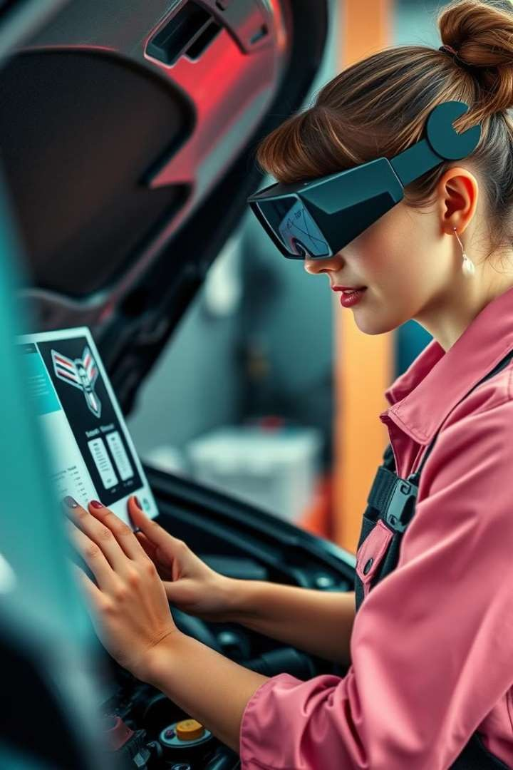
A Peek Under the Hood of Augmented Reality
1
Capture
Cameras and sensors such as motion sensors, depth-
sensing cameras capture the real-world environment.
2
Process
AI-powered algorithms process the captured data.
3
Display
Displays render digital elements over the real-world view.

Slide 4
Why AR is Transformative in Multiple Industries
Retail
Customers visualize products before purchase, enhancing shopping experiences.
Healthcare
Surgeons use AR for precise, guided operations, improving patient outcomes.
Education
Students explore 3D concepts, making learning more interactive and engaging.

Slide 5

From Window Shopping to Immersive Product Try-Ons
Virtual Try-Ons
Users can virtually try on clothes, glasses, or place furniture at home.
Reduced Returns
AR experiences lead to fewer product returns and higher customer
satisfaction.
Real-World Examples
IKEA Place and Lenskart demonstrate successful AR implementations in retail.

Slide 6




AR as the New Scalpel in the Operating Room
Precision Surgery
Surgeons visualize critical data like patient vitals and 3D models of organs in real-time during surgery.
Medical Training
AR provides interactive 3D simulations for safer medical student training.
Remote Assistance
AR enables specialists to assist in surgeries from afar.

Slide 7


Interactive Learning with Augmented Reality
Tangible Concepts
AR in classrooms turns abstract ideas into interactive 3D
experiences.
Multi-Sensory Engagement
Students retain information better through engaging multiple senses.
Educational Apps
Apps like Google Expeditions or Merge Cube help students visualize and interact with subjects like anatomy, history, and physics.

Slide 8
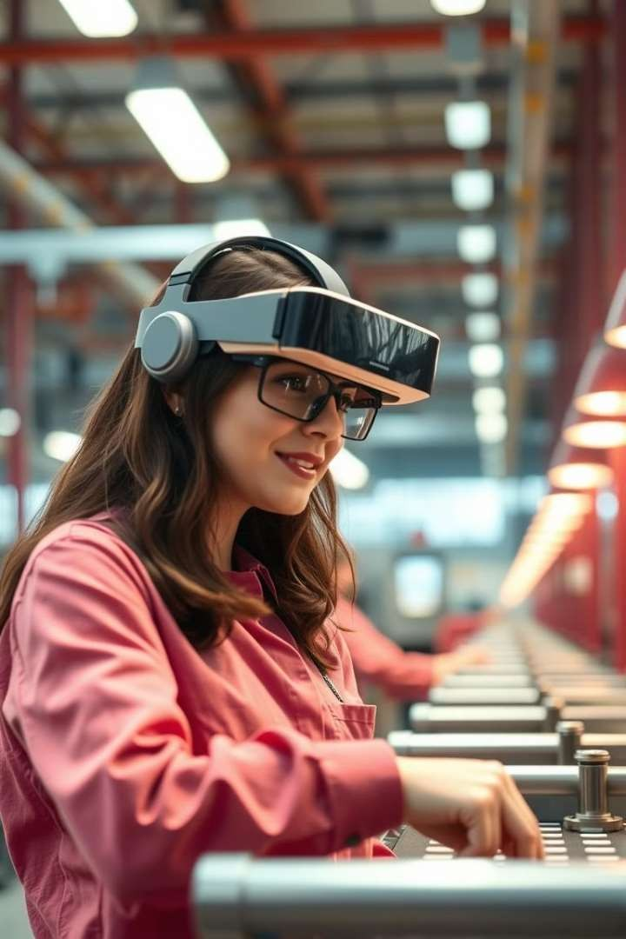
AR in the Factory: From Blueprints to Assembly
Function | Benefit
Real-time Instructions | Reduced Errors
Safety Checks | Improved Workplace Safety
Guided Repairs | Faster Training
Precision Assembly | Increased Productivity

Slide 9
Education
AR vs. Other Emerging Technologies
Healthcare
AI
IoT
AR
Provides real-time visual guidance enhancing precision with live data.
Analyzes data for diagnostic predictions but lacks interactive visual aids.
Connects devices for remote monitoring without real-
time visual assistance.
Retail
AR
Enables virtual try-ons and product visualizations, enhancing customer engagement.
AI
Offers personalized recommendations but lacks interactive product experiences.
IoT
Optimizes inventory and supply chain without direct customer engagement.
AR
Engages students with interactive 3D models for real-time learning.
AI
Personalizes education but lacks hands-on engagement.
IoT
Connects smart devices in classrooms but doesn’t enhance content delivery.
5G
Supports streaming and connectivity but lacks interactive dimensions.

Slide 10
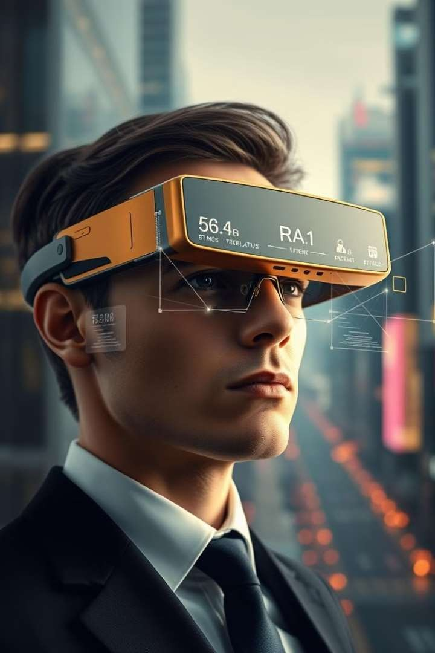

The Future of AR: From Smartphones to Smart Glasses
1
Wearable AR
Lightweight, everyday AR glasses will replace handheld devices.
They'll seamlessly integrate into our daily lives.
2
AI-Enhanced AR
AI will make AR interactions smarter. It'll provide personalized
information based on real-time context.
3
5G Integration
Ultra-fast 5G will enable seamless AR experiences. It'll minimize
latency for city-wide AR integrations.

Slide 11
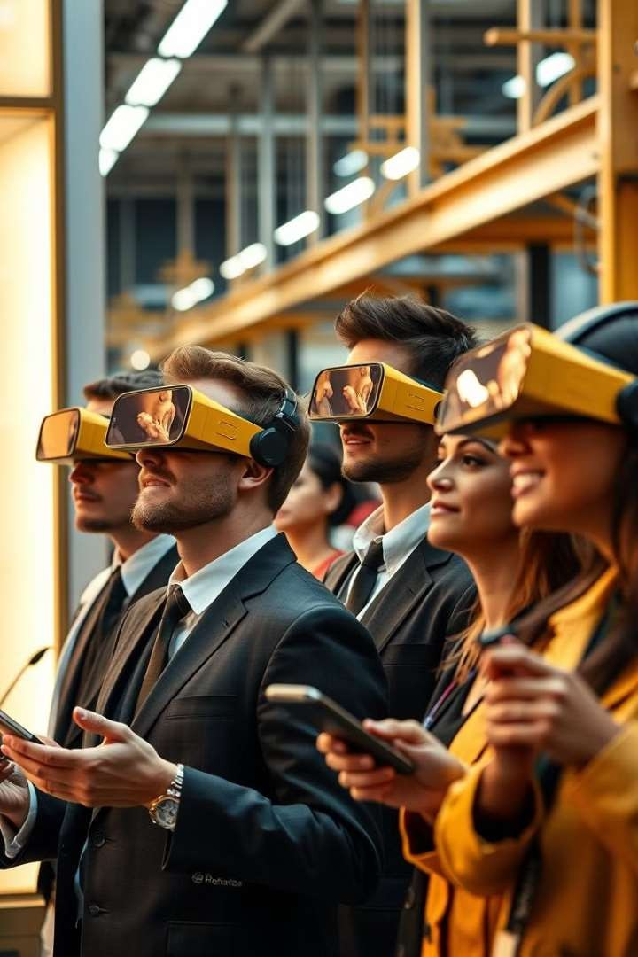



AR's Competitive Edge: Leading the Innovation Wave
Accessibility
AR's interactivity and immediacy make it more accessible than other emerging technologies.
Flexibility
Unlike VR, AR doesn't require full immersion. It's practical for everyday tasks and applications.
Versatility
AR has wide applicability across sectors. It's becoming integral in retail, education, and healthcare.

Slide 12
The Booming AR Market: Industry Growth and Projections
Market Size (2028) | $97.76 billion
Major Investors | Apple, Google, Facebook
AR Glasses Sales (2025) | 30+ million units

Slide 13
Overcoming Hurdles: Challenges in AR Development
Technical Limitations
Current AR devices face battery life and computing power constraints. Ongoing research aims to overcome these hurdles.
Cost Factors
High development and hardware costs pose challenges. Economies of scale will drive prices down over time.
User Experience
Comfort and usability of AR devices are improving. Next-gen designs focus on ergonomics and user- friendly interfaces.
Privacy
Concerns about data collection and user safety.

Slide 14
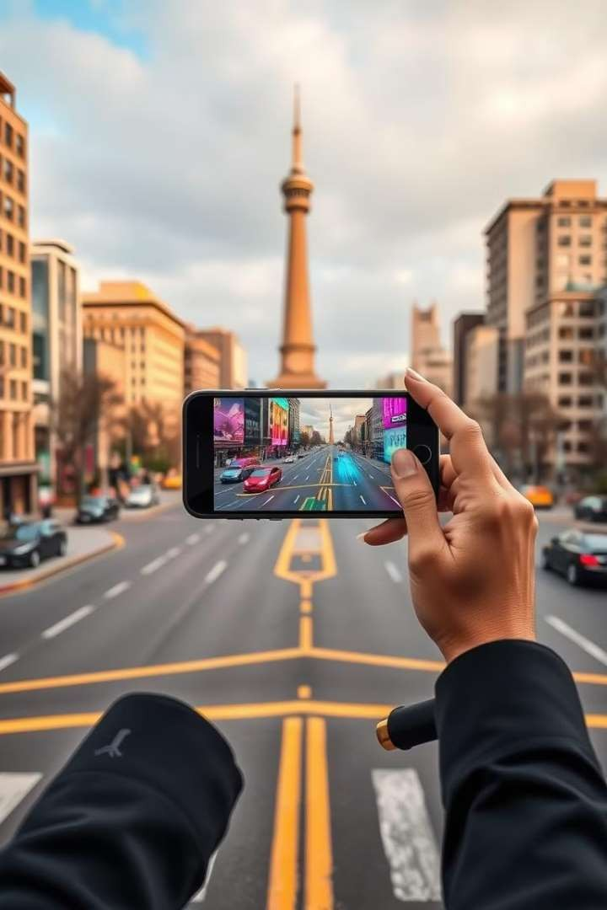
Conclusion: The Bridge to Our Digital Future
1
Transformative Potential
AR is reshaping how we interact with our environment. It's
enhancing experiences across various sectors.
2
Continuous Innovation
Ongoing advancements in AR technology promise even more
exciting applications. The future holds limitless possibilities.
3
Integration into Daily Life
As AR becomes more seamless, it will be an integral part of our
daily routines.

Slide 15
Thank You!

